Slide 1
MA3077 Operational Research Lecture 5 – Weak and strong duality in linear programming
Dr Marco Fasondini

Slide 2

Duality – the dual of the dual 1/3
The dual of
$$\begin{matrix}min & c^{T}x \\ s.t. & Ax=b \\ & x≥0\end{matrix}$$
is
$$\begin{matrix}max & b^{T}y \\ s.t. & c −A^{T}y=s \\ & s≥0, y∈ ℝ^{m}\end{matrix},$$
which we can also write as
$$\begin{matrix}max & b^{T}y \\ s.t. & c −A^{T}y≥0 \\ & y∈ ℝ^{m}\end{matrix}$$

Slide 3
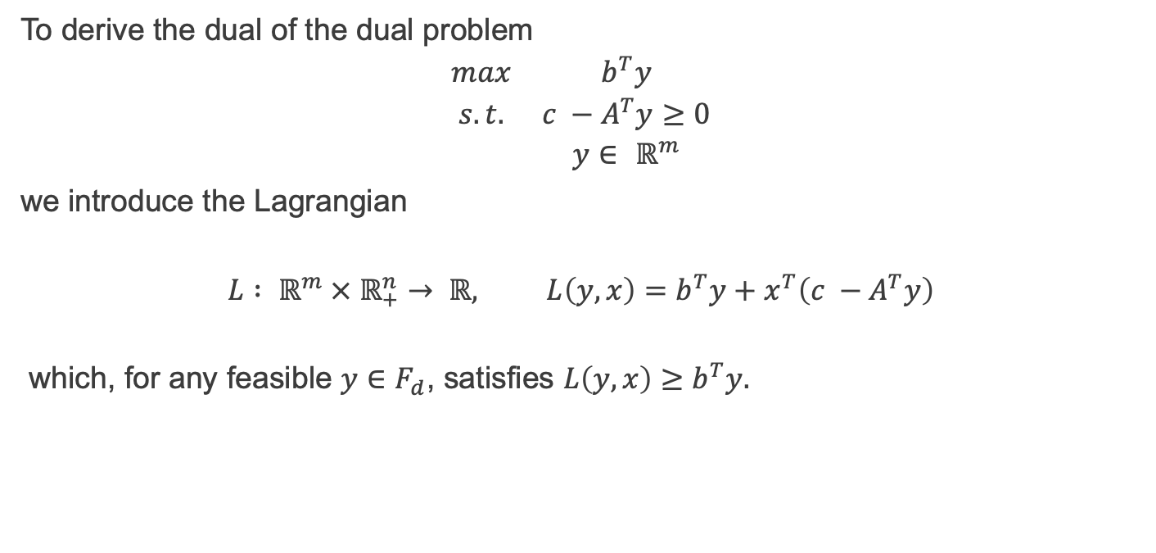
Duality – the dual of the dual 2/3
To derive the dual of the dual problem
$$\begin{matrix}max & b^{T}y \\ s.t. & c −A^{T}y≥0 \\ & y∈ ℝ^{m}\end{matrix}$$
we introduce the Lagrangian
$$L : ℝ^{m} × ℝ_{+}^{n}→ ℝ, L\left(y,x\right)=b^{T}y+x^{T}\left(c −A^{T}y\right)$$
which, for any feasible $y∈F_{d}$, satisfies $L\left(y,x\right)≥b^{T}y.$

Slide 4
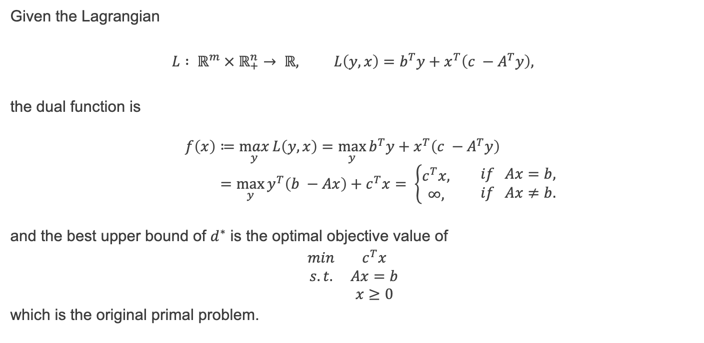
Duality – the dual of the dual 3/3
Given the Lagrangian
$$L : ℝ^{m} × ℝ_{+}^{n}→ ℝ, L\left(y,x\right)=b^{T}y+x^{T}\left(c −A^{T}y\right),$$
the dual function is
$$f\left(x\right)≔\max_{y}{L\left(y,x\right)}=\max_{y}{b^{T}y+x^{T}\left(c −A^{T}y\right)} \\ =\max_{y}{y^{T}\left(b −Ax\right)+c^{T}x}= \left\{\begin{aligned}c^{T}x, \\ ∞,\end{aligned} \begin{matrix}if Ax=b, \\ if Ax≠b.\end{matrix}\right.$$
and the best upper bound of $d^{∗}$ is the optimal objective value of
$$\begin{matrix}min & c^{T}x \\ s.t. & Ax=b \\ & x≥0\end{matrix}$$
which is the original primal problem.

Slide 5
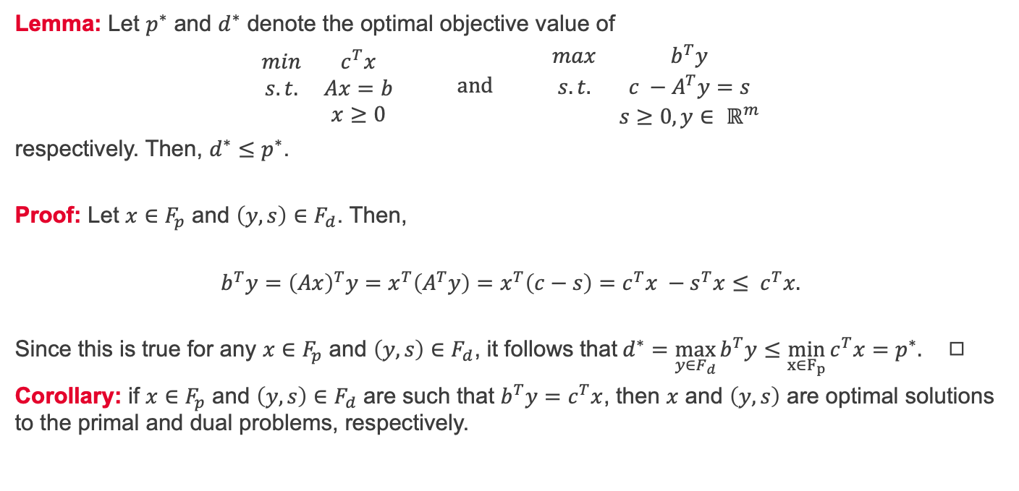
Weak duality
Lemma: Let $p^{∗}$ and $d^{∗}$ denote the optimal objective value of
$$\begin{matrix}min & c^{T}x \\ s.t. & Ax=b \\ & x≥0\end{matrix} and \begin{matrix}max & b^{T}y \\ s.t. & c −A^{T}y=s \\ & s≥0, y∈ ℝ^{m}\end{matrix}$$
respectively. Then, $d^{∗}≤p^{∗}$.
Proof: Let $x∈F_{p}$ and $\left(y,s\right)∈F_{d}$. Then,
$$b^{T}y={\left(Ax\right)}^{T}y=x^{T}\left(A^{T}y\right)=x^{T}\left(c−s\right)=c^{T}x −s^{T}x≤ c^{T}x.$$
Since this is true for any $x∈F_{p}$ and $\left(y,s\right)∈F_{d}$, it follows that$d^{∗}=\max_{y∈F_{d}}{b^{T}y}≤\min_{x∈F_{p}}{c^{T}x}=p^{∗}.$ ◻︎
Corollary: if $x∈F_{p}$ and $\left(y,s\right)∈F_{d}$ are such that $b^{T}y=c^{T}x$, then $x$ and $\left(y,s\right)$ are optimal solutions to the primal and dual problems, respectively.

Slide 6
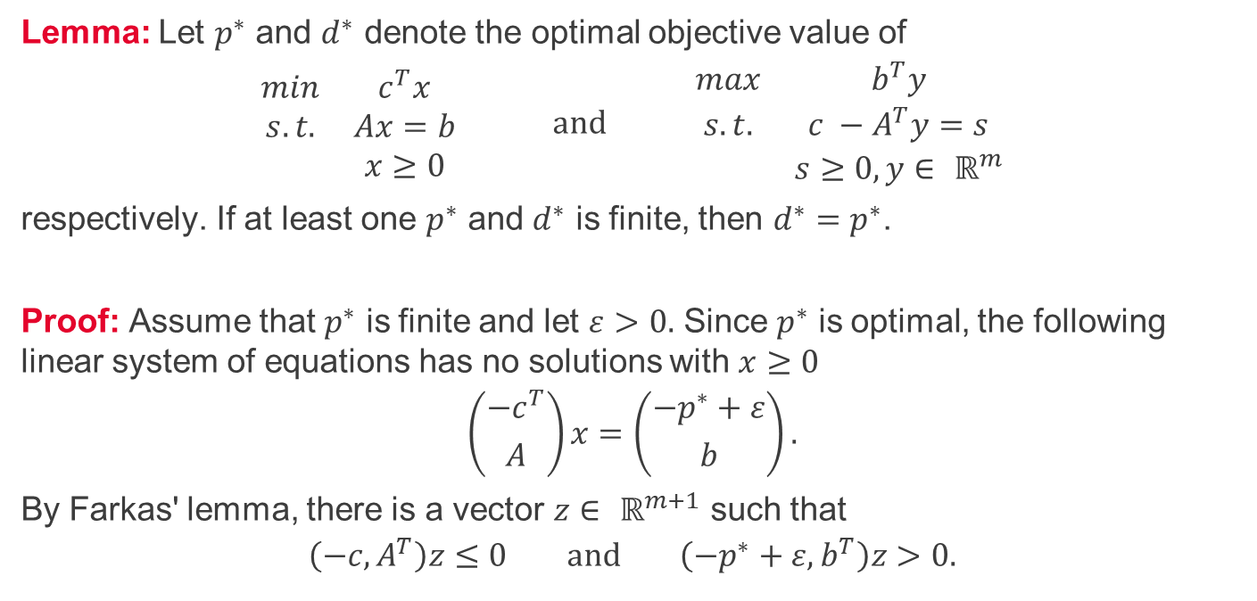
Strong duality 1/3
Lemma: Let $p^{∗}$ and $d^{∗}$ denote the optimal objective value of
$$\begin{matrix}min & c^{T}x \\ s.t. & Ax=b \\ & x≥0\end{matrix} and \begin{matrix}max & b^{T}y \\ s.t. & c −A^{T}y=s \\ & s≥0, y∈ ℝ^{m}\end{matrix}$$
respectively. If at least one $p^{∗}$ and $d^{∗}$ is finite, then $d^{∗}=p^{∗}$.
Proof: Assume that $p^{∗}$ is finite and let $ε>0.$ Since $p^{∗}$ is optimal, the following linear system of equations has no solutions with $x≥0$
$$\left({−c^{T} \atop A}\right)x=\left({−p^{∗}+ε \atop b}\right).$$
By Farkas' lemma, there is a vector $z∈ ℝ^{m+1}$ such that
$$\left(−c, A^{T}\right)z≤0 and \left(−p^{∗}+ε, b^{T}\right)z>0.$$

Slide 7
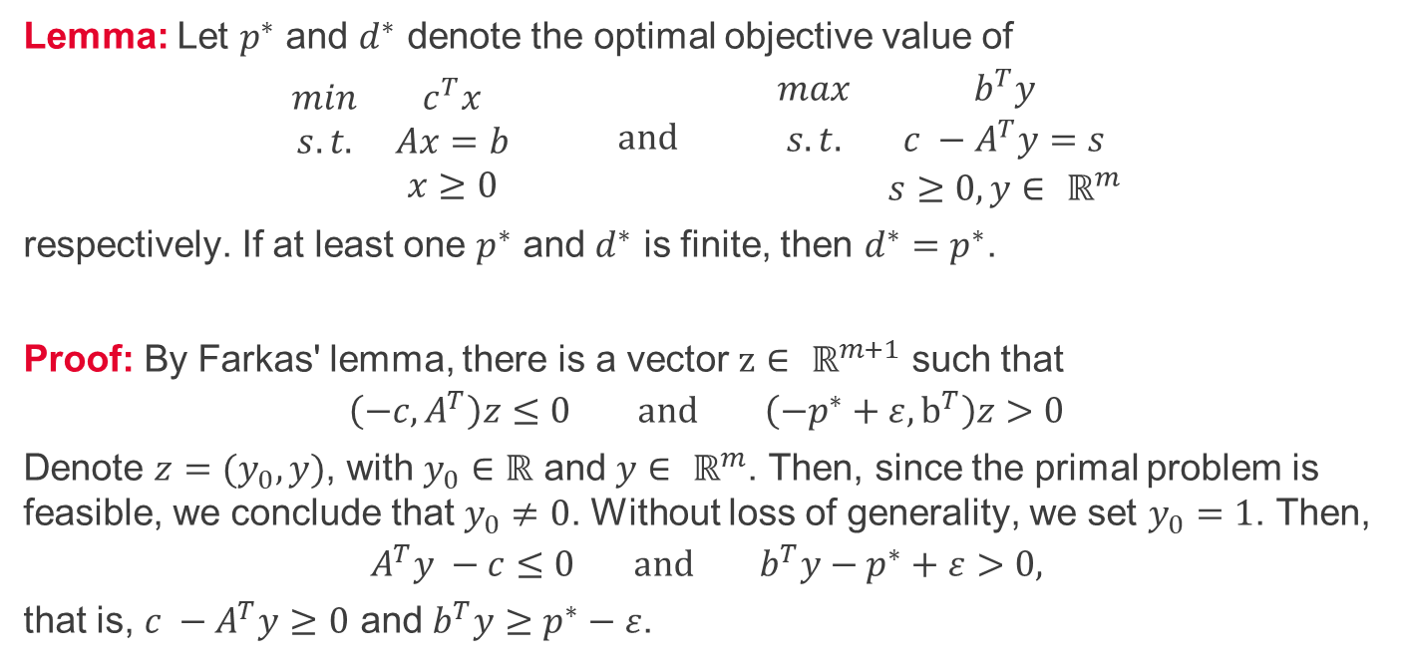
Strong duality 2/3
Lemma: Let $p^{∗}$ and $d^{∗}$ denote the optimal objective value of
$$\begin{matrix}min & c^{T}x \\ s.t. & Ax=b \\ & x≥0\end{matrix} and \begin{matrix}max & b^{T}y \\ s.t. & c −A^{T}y=s \\ & s≥0, y∈ ℝ^{m}\end{matrix}$$
respectively. If at least one $p^{∗}$ and $d^{∗}$ is finite, then $d^{∗}=p^{∗}$.
Proof: By Farkas' lemma, there is a vector $z∈ ℝ^{m+1}$ such that
$$\left(−c, A^{T}\right)z≤0 and \left(−p^{∗}+ε, b^{T}\right)z>0$$
Denote $z=(y_{0}, y)$, with $y_{0}∈ℝ$ and $y∈ ℝ^{m}$. Then, since the primal problem is feasible, we conclude that $y_{0}≠0$. Without loss of generality, we set $y_{0}=1$. Then,
$$A^{T}y −c≤0 and b^{T}y−p^{∗}+ε>0,$$
that is, $c −A^{T}y≥0$ and $b^{T}y≥p^{∗}−ε$.

Slide 8
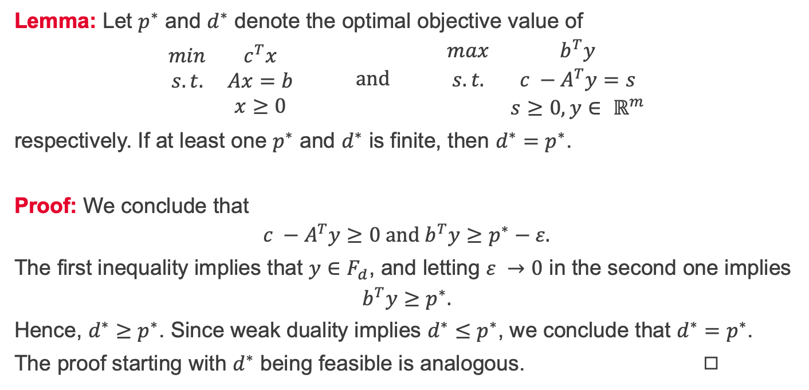
Strong duality 3/3
Lemma: Let $p^{∗}$ and $d^{∗}$ denote the optimal objective value of
$$\begin{matrix}min & c^{T}x \\ s.t. & Ax=b \\ & x≥0\end{matrix} and \begin{matrix}max & b^{T}y \\ s.t. & c −A^{T}y=s \\ & s≥0, y∈ ℝ^{m}\end{matrix}$$
respectively. If at least one $p^{∗}$ and $d^{∗}$ is finite, then $d^{∗}=p^{∗}$.
Proof: We conclude that
$$c −A^{T}y≥0 and b^{T}y≥p^{∗}−ε.$$
The first inequality implies that $y∈F_{d}$, and letting $ε →0$ in the second one implies
$$b^{T}y≥p^{∗}.$$
Hence, $d^{∗}≥p^{∗}$. Since weak duality implies $d^{∗}≤p^{∗}$, we conclude that $d^{∗}=p^{∗}$.
The proof starting with $d^{∗}$ being feasible is analogous. ◻︎

Slide 9
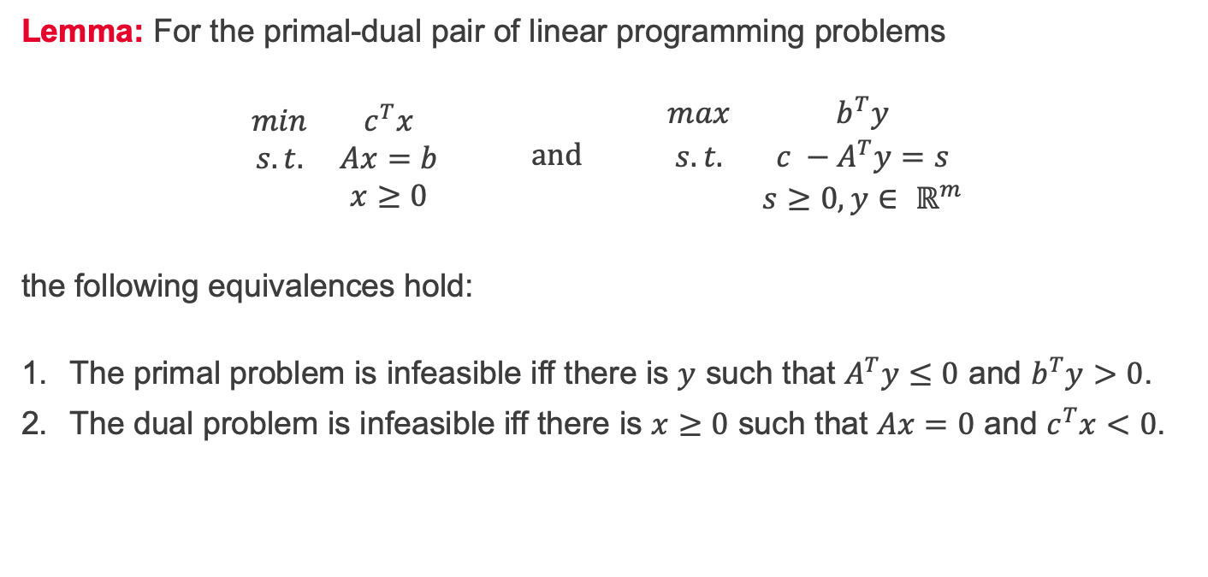
Primal and dual Farkas' lemma
Lemma: For the primal-dual pair of linear programming problems
$$\begin{matrix}min & c^{T}x \\ s.t. & Ax=b \\ & x≥0\end{matrix} and \begin{matrix}max & b^{T}y \\ s.t. & c −A^{T}y=s \\ & s≥0, y∈ ℝ^{m}\end{matrix}$$
the following equivalences hold:
The primal problem is infeasible iff there is $y$ such that $A^{T}y≤0$ and $b^{T}y>0$.
The dual problem is infeasible iff there is $x≥0$ such that $Ax=0$ and $c^{T}x<0$.

Slide 10
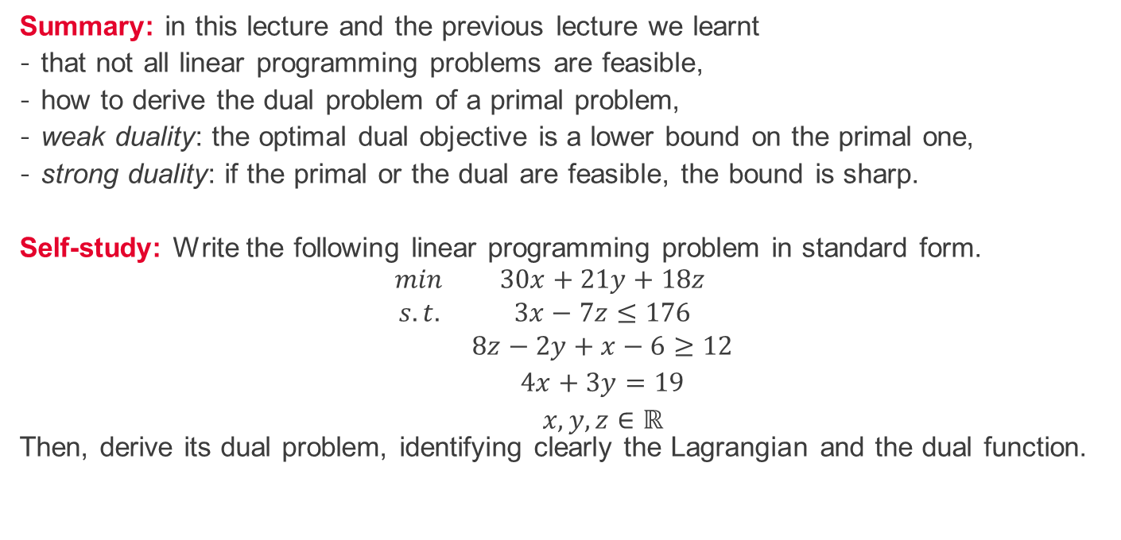
Summary and self-study
Summary: in this lecture and the previous lecture we learnt
that not all linear programming problems are feasible,
how to derive the dual problem of a primal problem,
weak duality: the optimal dual objective is a lower bound on the primal one,
strong duality: if the primal or the dual are feasible, the bound is sharp.
Self-study: Write the following linear programming problem in standard form. $$\begin{matrix}min & 30x+21y+18z \\ s.t. & 3x−7z≤176 \\ & 8z−2y+x−6≥12 \\ & 4x+3y=19 \\ & x,y, z∈ℝ\end{matrix}$$
Then, derive its dual problem, identifying clearly the Lagrangian and the dual function.

